Slide 1
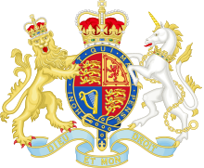
Queen Victoria Life & Family

Slide 2
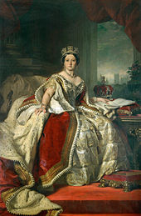
Alexandrina Victoria
She reigned from 1837 to 1901
She was the Queen of Great Britain, Ireland and also Emperess of India since 1876
Her reign, which was called Victorian Age, lasted 63 years, 7 months and two days

Slide 3
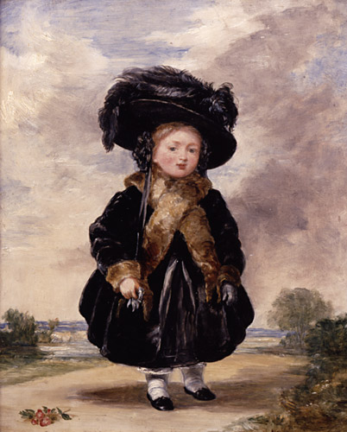
Her childhood
She was born on the 24 of May 1819
Her father was prince Edward Duke of Kent, the fourth son of King George III
Her German-born mother was Princess Victoria of Saxes-Coburg-Saalfeld
She was their only child and she was the fifth heir to the throne after her uncles
She defined her childhood as «rather melancholic» because her mother was very protective and isolated her from other children

Slide 4
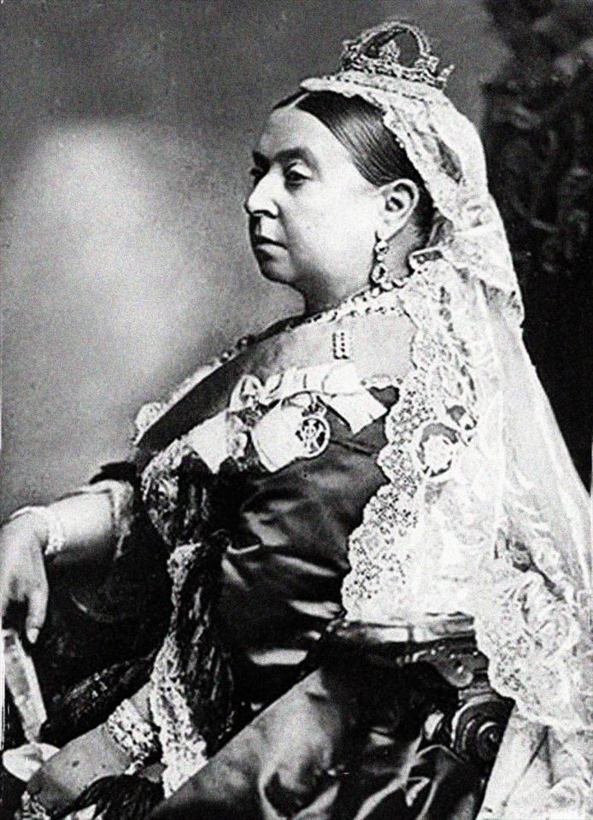
Victorian celebrity
She was determinate, rebel, strong and fragile
She asked her husband to marry her
She knew English, Italian, German, French, Latin and Greek
She was short, ugly and fat

Slide 5
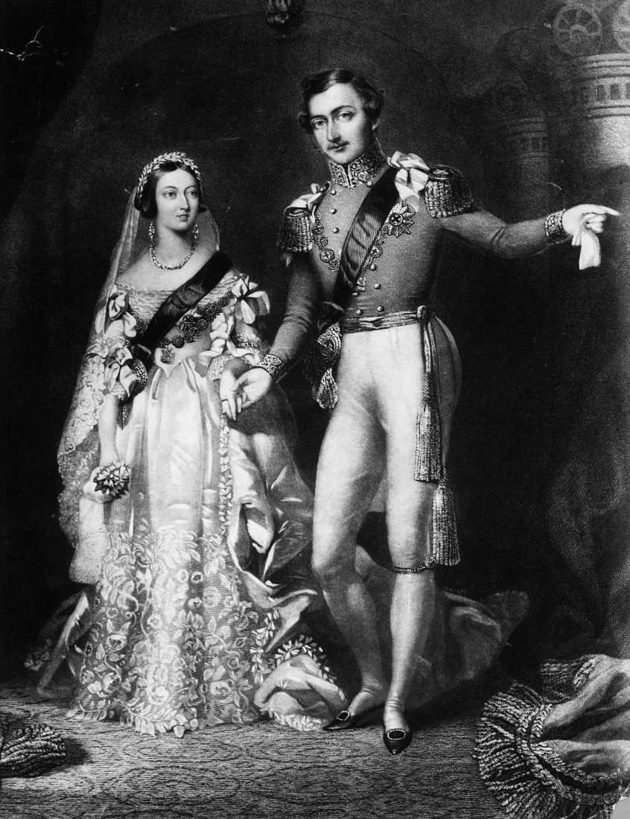
The family
In 1840 ,after marrying her cousin Prince Albert of Saxes-Coburg-Saalfeld , she gave birth to 9 children and from then she had 42 grandsons
The name of her children were: Victoria , Albert , Alice , Alfred , Helen, Luis , Arthur , Leopold and the last one Beatrice
During her first pregnancy in 1840, an 18 years old Eduard Oxford attempted to assassinate her but he failed

Slide 6
Curiosity:
She cheated with her servant John Brown, with Disraeli and with Abdul Karim after her husband died; recently a movie has come out talking about Queen Victoria
She had a lot of dogs and she loved their sincerity
After her wedding the tradition of white wedding dress was widespread
During her reign the tradition of drinking tea at 5 o’clock was developed
A lot of places took her name

Slide 7
The End
Written by:
Lotito Davide
Nicole Mammone
Charles Ossola
Enrico Pellegrino

