Slide 1


“Underwater applications of the Ambisonics technology”
University of Parma
Industrial Engineering Department
HTTP://ied.unipr.it
Author: Angelo Farina – HTTP://www.angelofarina.it
E-mail: farina@unipr.it – Skype: angelo.farina

Slide 2
Goals
Explanation of the Ambisonics technology, as currently employed in room acoustics
Brahma: the first underwater 4-channels digital sound recorder
A tetrahedrical hydrophone array for Brahma
Sound source localization from Ambisonics
(B-format) recordings
Noise immission mapping employing a modified version of the CITYMAP computer program

Slide 3
Ambisonics technology
Ambisonics was invented in the seventies by Michael Gerzon (UK)
It was initially a method for recording a 4-channel stream, which later was played back inside a special loudspeaker rig
It is based on the pressure-velocity decomposition of the sound field at a point
It makes it possible to capture the complete three-dimensional sound field, and to reproduce it quite faithfully

Slide 4
Ambisonics recording and playback
Reproduction occurs over an array of 8-24 loudspeakers, through an Ambisonics decoder

Slide 5
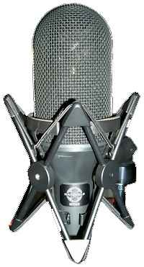

Ambisonics Technology
Recording
Processing
Decoding
Speaker-feeds
Playback
Encoding
B-Format
Notes:
Ambisonic surround sound è un set di tecniche per la registrazione, l’elaborazione in studio e la riproduzione dell’intero campo sonoro incontrato durante la ripresa. La modalità con cui Ambisonic realizza la più fedele riproduzione possibile consiste nel progettare tutta la catena di passaggi che dalla ripresa dell’evento sonoro lo portano fino alle orecchie degli ascoltatori. Attraverso un processo di codifica, un definito set di segnali chiamato B-Format ed un processo di decodifica, riesce ad ottenere un ambiente di riproduzione, in cui lo spettatore ha più ampia libertà di movimento all’interno dell’area d’ascolto senza correre il rischio di compromettere l’immagine sonora.

Slide 6
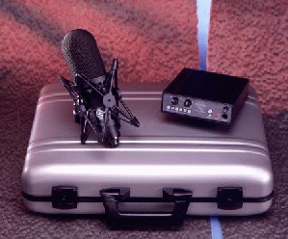
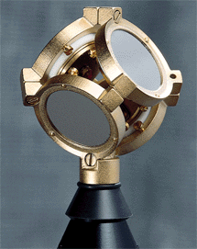
The Soundfield microphone
This microphone is equipped with 4 subcardioid capsules, placed on the faces of a thetraedron
The signal are analogically processed in its own special control box, which derives 4 “B-format” signals
These signals are:
  W : omnidirectional (sound pressure)
  X,Y,Z : the three figure-of-eight microphones aligned with the ISO cartesian reference system – these signals are the cartesian components of the “particle velocity” vector

Slide 7
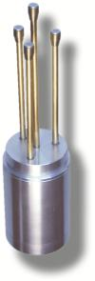
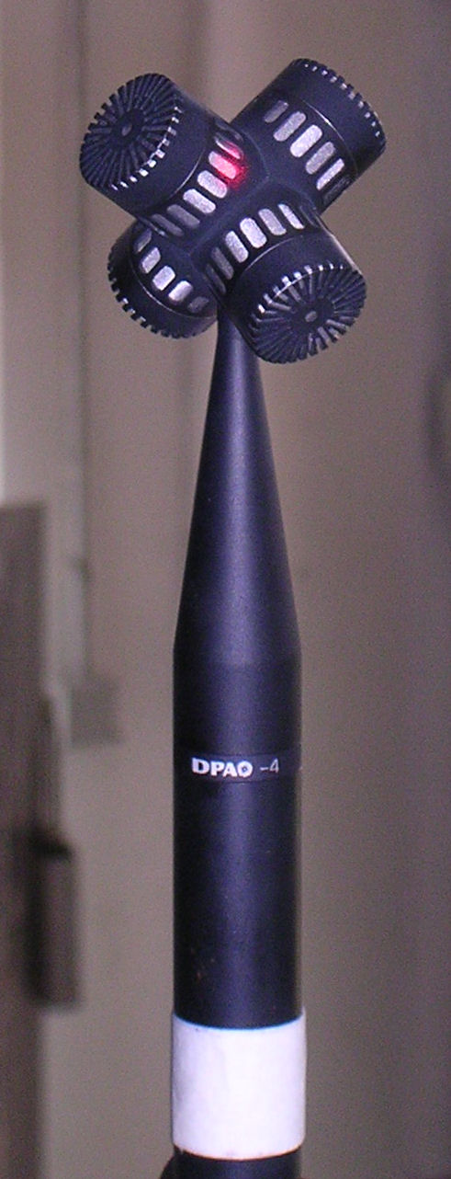
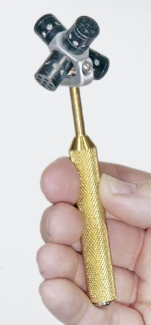
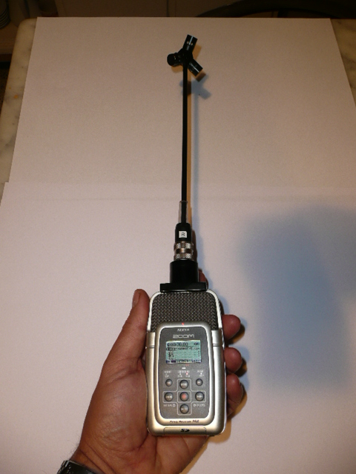
Other tetrahedrical microphones
Trinnov, DPA, CoreSound, Brahma are other microphone systems which record natively the A-format signals, which later are digitally converted to B-format

Slide 8





The B-format components
Physically, W is a signal proportional to the pressure, XYZ are signals proportional to the three Cartesian components of the particle velocity
when a sound wave impinges over the microphone from the “negative” direction of the x-axis, the signal on the X output will have polarity reversed with respect to the W signal

Slide 9
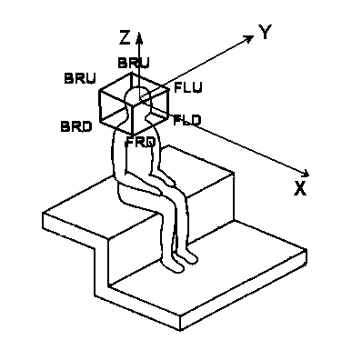
A-format to B-format
The A-format signals are the “raw” signals coming from the 4 capsules, loated at 4 of the 8 vertexes of a cube, typically at locations FLU-FRD-BLD-BRU

Slide 10
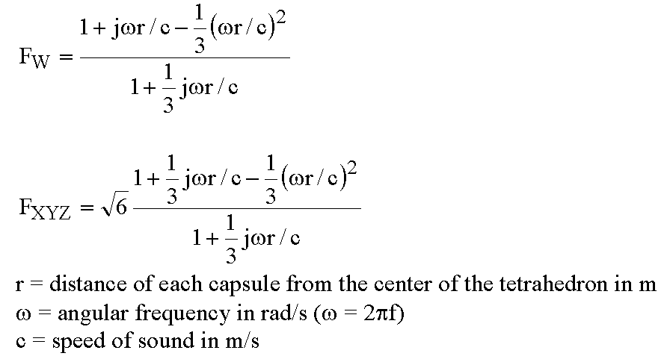
A-format to B-format
The A-format signals are converted to the B-format signals by matrixing:
W' = FLU+FRD+BLD+BRU
X' = FLU+FRD-BLD-BRU
Y' = FLU-FRD+BLD-BRU
Z' = FLU-FRD-BLD+BRU
and then applying proper filtering:

Slide 11
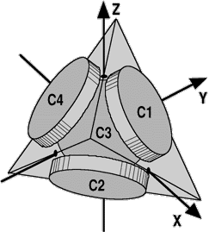
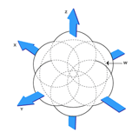
Recording
Recording
Processing
Decoding and Playback
Encoding
X
Y
Z
W
Directional components: velocity
Omnidirectional component: pressure
Soundfield Microphone
B-FORMAT
Polar Diagram
Notes:
Il soundfield è un microfono che include nella sua struttura un array di quattro capsule che catturano il suono in tre dimenzioni senza presentare errori di fase e formano il diagramma polare caratteristico. Effettuando una registrazione con il soundfiled si ottengono in output 4 segnali audio: 3 componenti direzionali contenenti informazioni sulla la velocità del suono lungo gli assi
X
Y
Z
ed una componente omnidirezionale che da informazioni sulla pressione sonora.
L’insieme delle quattro componenti audio costituisce il set di segnali di codifica della tecnologia Ambisonic chiamato B-Format.
E’evidente che se la registrazione è fatta con il soundfield non occorrono processi di codifica.

Slide 12




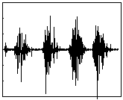
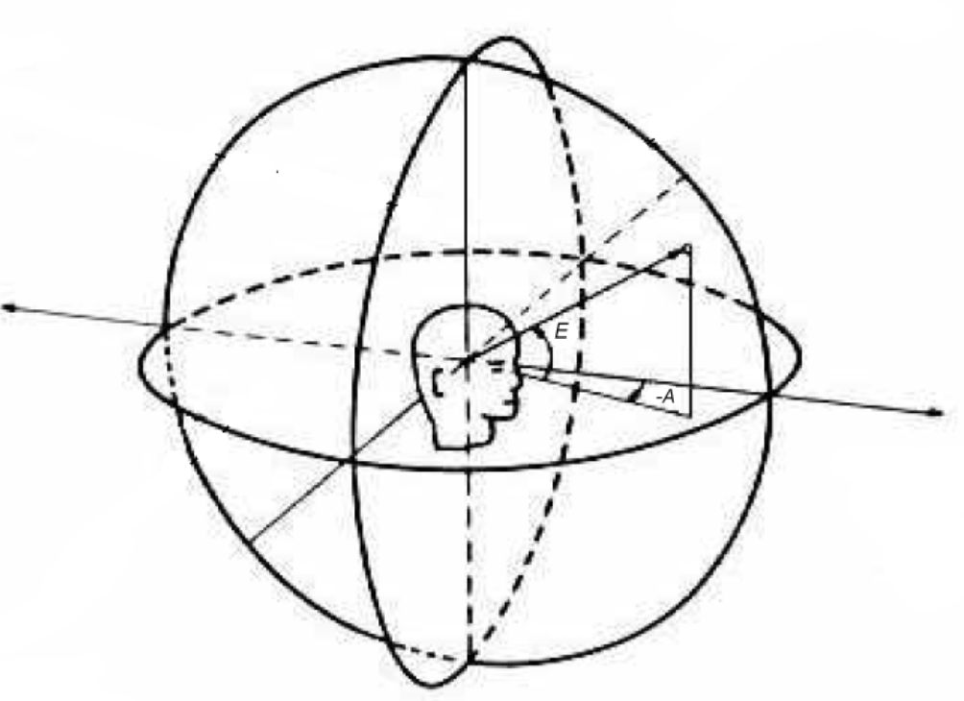
Encoding (synthetic B-format)
Recording
Processing
Decoding and Playback
Encoding
0 | W
1 | X
 | Y
 | Z
=0,707
*s(t)
=cos(A)cos(E)
*s(t)
=sin(A)cos(E)
*s(t)
=sin(E)
*s(t)
s(t)=
Notes:
Nel processo di codifica, implementato da Isaac e me su DSP, vengono assegnate delle coordinate spaziali a sorgenti mono tramite un set di quattro equazioni.
L’algoritmo matematico, proposto da Gerzon, che porta alle equazioni, scinde la direzione del campo sonoro in componenti armoniche sferiche di ordine zero ed uno. Ponendo l’ascoltatore nell’origine degli assi, tutti gli eventi acustici possono essere rappresentati da quattro componenti fondamentali:
W
X
Y
Z
Dove A ed E sono rispettivamente gli angoli di Azimuth (rotazione antioraria rispetto ad un asse di riferimento) ed Elevation (angolo di elevazione).
Moltiplicando l’ampiezza variabile nel tempo della sorgente sonora per i coefficienti dati dalle armoniche sferiche, la si dispone sulla superficie della sfera unitaria data da:
EQUAZIONE
che circonda l’ascoltatore.
W, X, Y, Z diventano così la codifica B-Format di s(t).

Slide 13
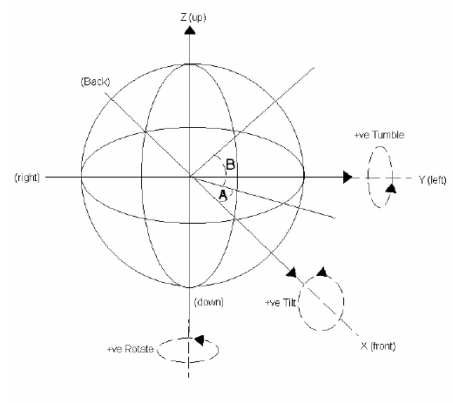
Processing
Recording
Processing
Decoding and Playback
Encoding
Rotation
Tilt
Tumble
Notes:
Una volta ottenuto il B-Format, è possibile intervenire su di esso per cambiare la direzione del compo sonoro senza ricodificare tutte le sorgenti:

Slide 14
Decoding & Playback
Recording
Processing
Decoding and Playback
Encoding
Each speaker feed is simply a weighted sum of the 4 B-format signals.
The weighting coefficients are computed by the cosines of the angles between the loudspeaker and the three Cartesian axes

Slide 15
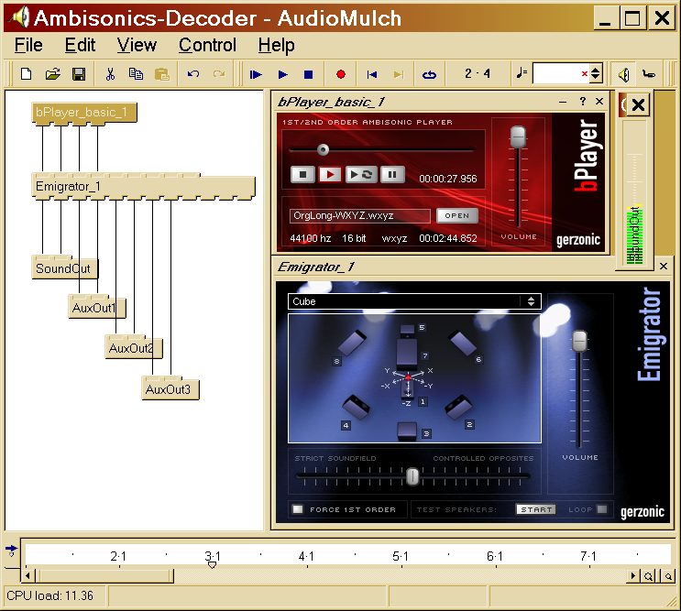
Software for Ambisonics decoding
Audiomulch VST host
Gerzonic bPlayer
Gerzonic Emigrator

Slide 16
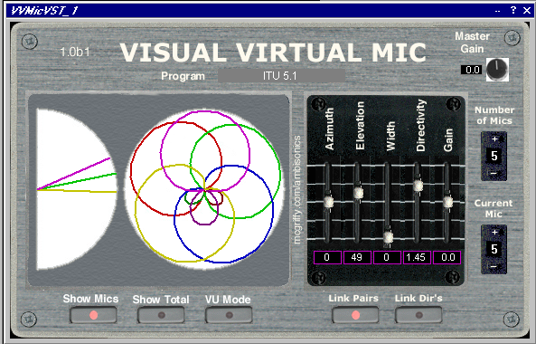
Software for Ambisonics processing
Visual Virtual Microphone by David McGriffy (freeware)

Slide 17
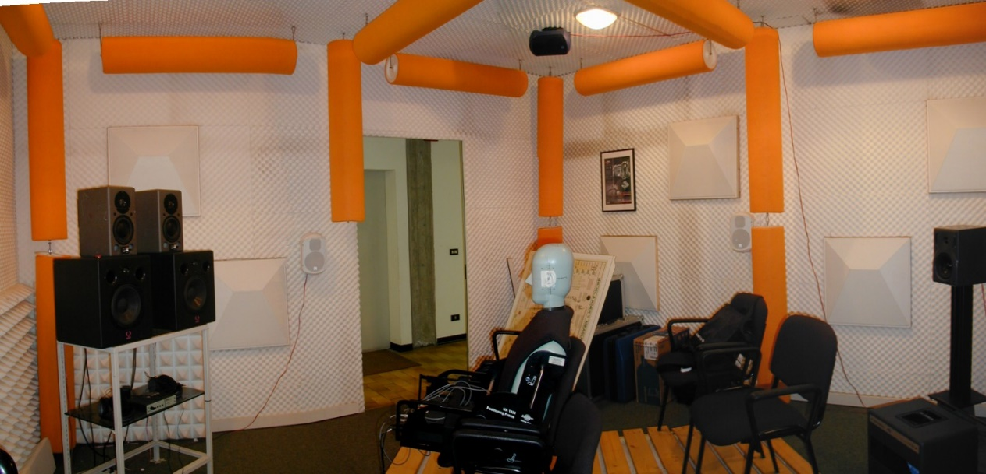
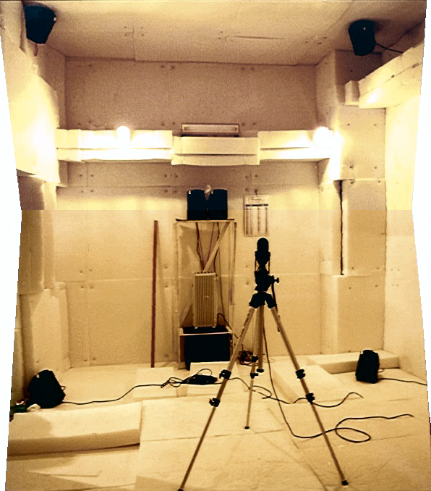
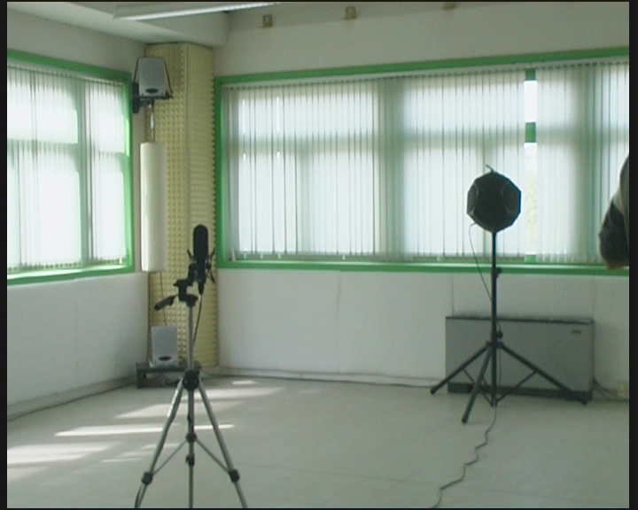
Rooms for Ambisonics playback
ASK (UNIPR) – Reggio Emilia
University of Ferrara
University of Bologna

Slide 18
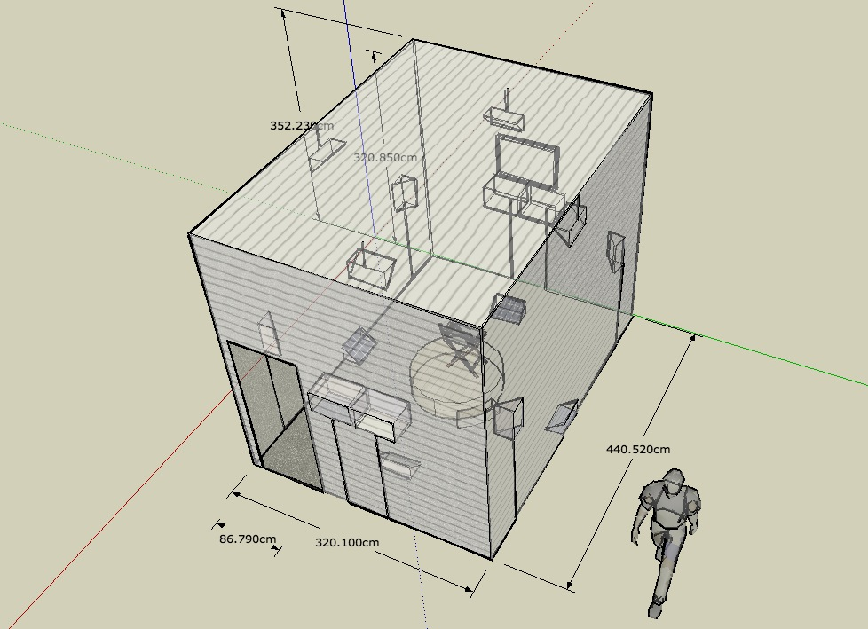
Rooms for Ambisonics playback
University of Parma (Casa della Musica)

Slide 19
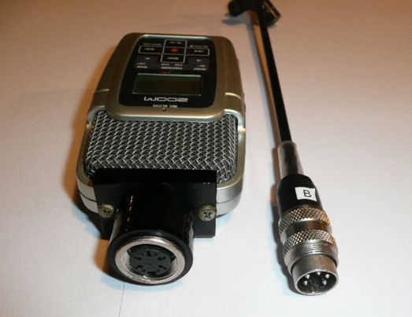
BRAHMA: 4-channels recorder
A Zoom H2 digital sound recorder is modified in India, allowing 4 independent inputs with phantom power supply

Slide 20
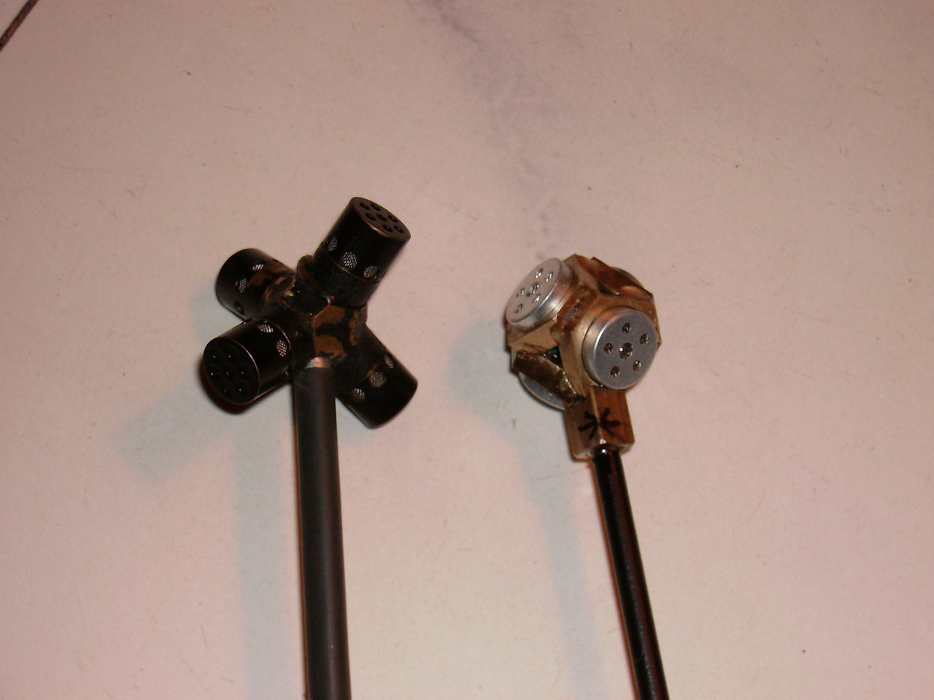
BRAHMA: 4-channels recorder
The standard microphone system is usually a terahedrical probe equipped with 4 cardioid electrect microphones

Slide 21
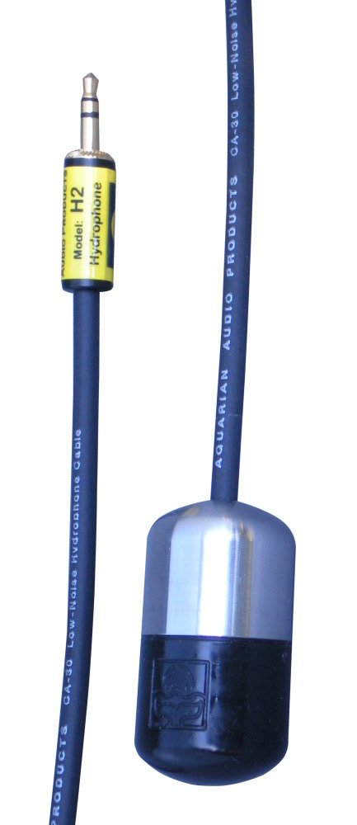
Hydrophones for Brahma
Brahma provides phantom power (5V) for transducers equipped with integral electronics. Hence the ideal hydrophone is the Acquarian Audio H2A:
Aquarian Audio Products
A division of AFAB Enterprises
1004 Commercial Ave. #225 Anacortes, WA 98221 USA
(360) 299-0372 www.AquarianAudio.com

Slide 22
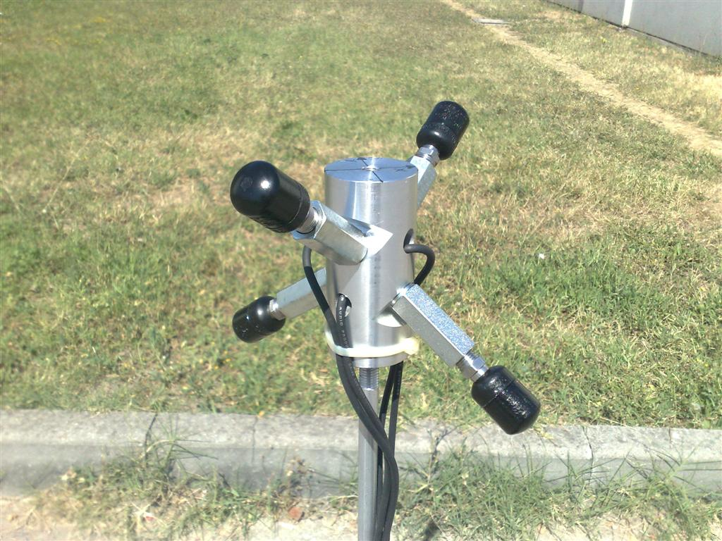
Underwater probe for Brahma
For underwater recordings, a special setup of 4 screw-mounted hydrophones is available:

Slide 23
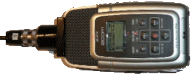
Underwater case for Brahma
Due to the small size (like a cigarette packet) it is easy to insert the Brahma inside a waterproof cylindrical container, sealed with O-rings
An external lead-acid battery can be included for continuous operation up to one week (in level-activated recording mode)
cable
6V 12 Ah battery

Slide 24
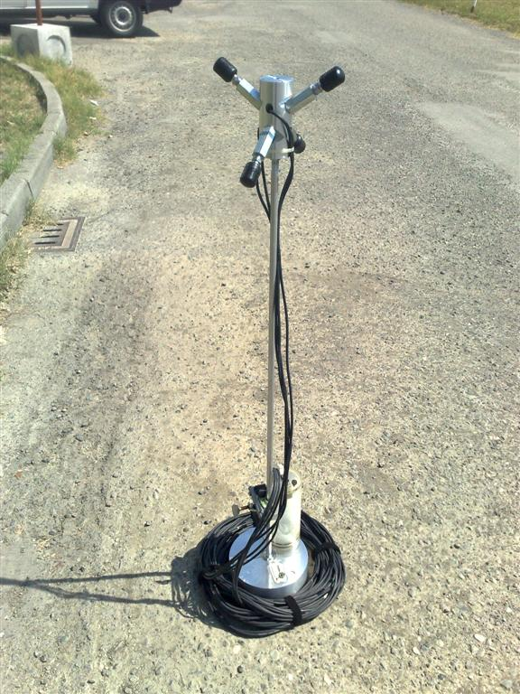
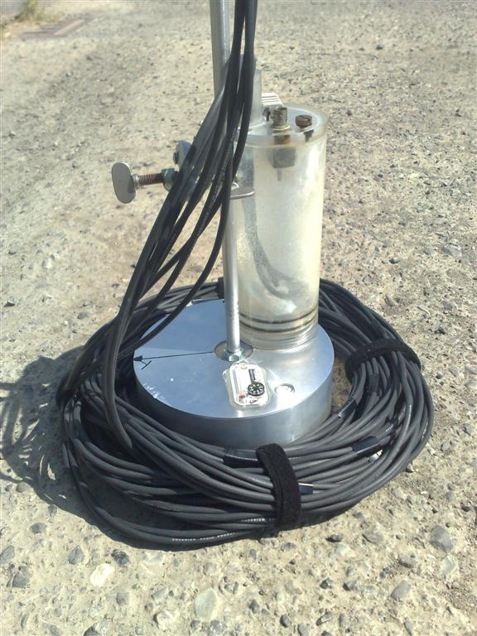
BRAHMA: 4-channels recorder
The probe can be mounted on a weighted base, allowing for underwater placement of the recorded, inside a waterproof case. However, the cables are long enough (15m) also for keeping the recorder on the boat

Slide 25
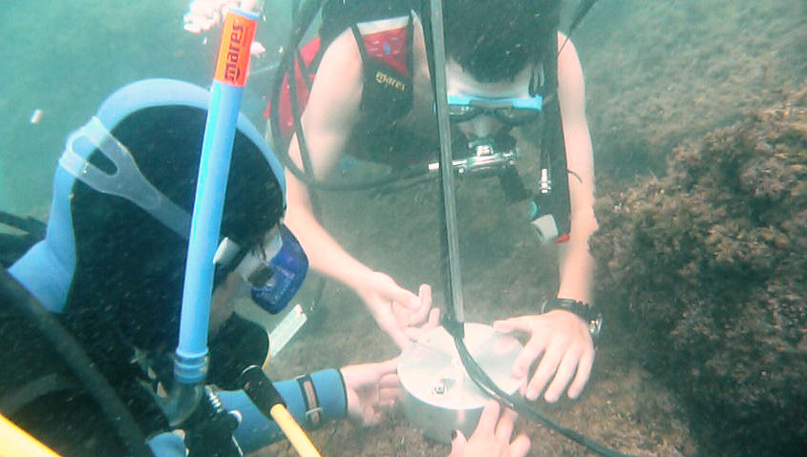
BRAHMA: 4-channels underwater recorder
The system is aligned vertically by means of a bubble scope, and horizontally by means of a magnetic compass:

Slide 26
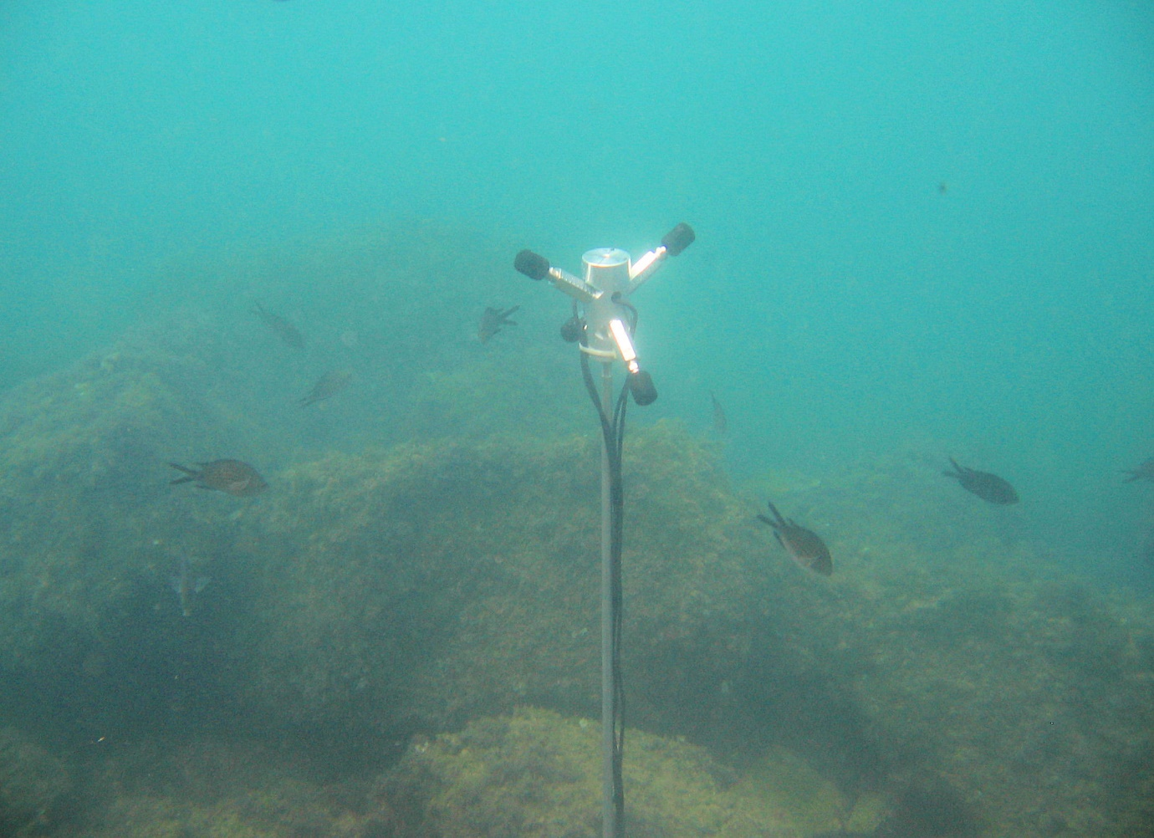
BRAHMA: 4-channels underwater recorder
Once placed on the sea bed, the system is usually well accepted (and ignored) by the marine life:

Slide 27
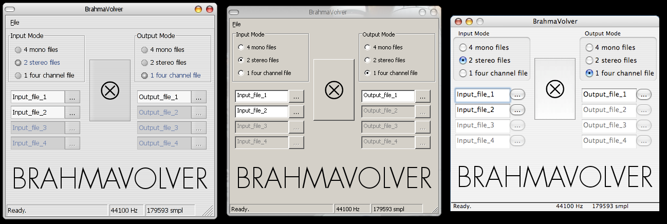
Brahmavolver: the processing software
Brahma records A-format signals. They can be converted to standard B-format by means of the Brahmavolver program, running on Linux / Windows / Mac-OSX

Slide 28
BRAHMA: technical specs
Sampling rates: 44.1 kHz, 48 kHz, 96 kHz (2 ch. only)
Recording format: 1 or 2 stereo WAV files on SD card
Bit Resolution: 16 or 24 bits
3 fixed gain settings, with 20 dB steps (traceable)
Memory usage: 1.9 Gbytes/h (@ 44.1 kHz, 24 bits, 4 ch.)
Recording time: more than 16 hours (with 32 Gb SD card)
Power Supply: 6 V DC, 200 mA max
Automatic recording when programmable threshold is exceeded
The SD card can be read and erased through the USB port

Slide 29
Source localization from B-format signals
At every instant, the source position is known in spherical coordinates by analyzing the B-format signal
z
boat
buoy
θ
y
α
Tetrahedrical hydrophonic probe
α = azimuth - θ = elevation
x

Slide 30
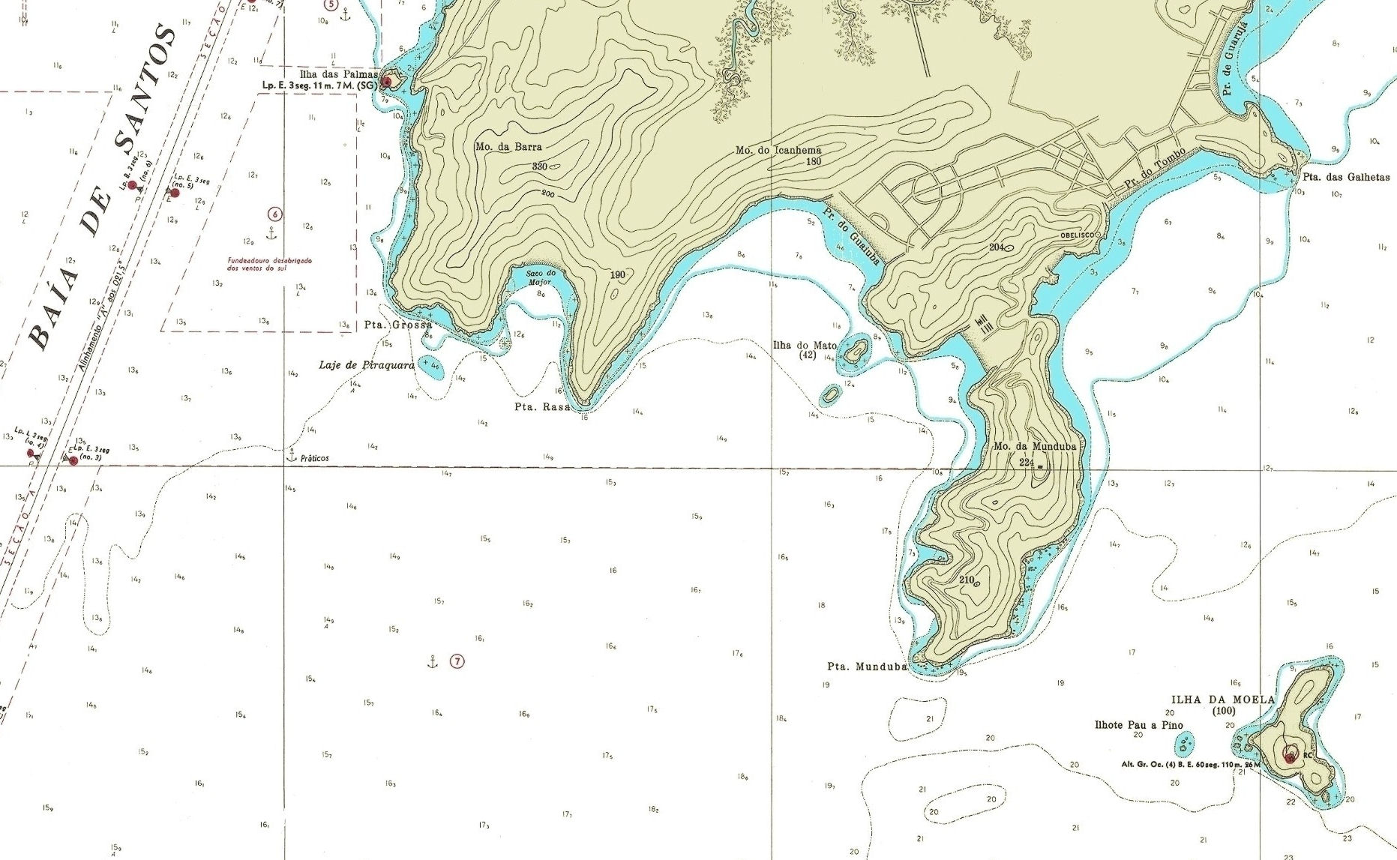
Trajectory from multiple recording buoys
Employing several buoys, the complete trajectory can be triangulated

Slide 31
Underwater extension of Citymap
If Citymap is to be employed for underwater applications, two main modifications are required:
  A new data-base of marine noise sources needs to be compiled
  The propagation algorithm must be replaced with a more realistic one, which takes into account the inhomogeneous medium and the multiple reflections between sea surface and sea floor.
The first task is accomplished by performing thousands of recording of pass-by recordings with various types of boats, at various speeds, and with different sea state
The second task requires a substantial effort for the software developer, who will have to rewrite completely the subroutine which performs the computations

Slide 32
Example of usage of Underwater Citymap
Mapping of underwater sound pressure level due to a boat along a trajectory

Slide 33
Internet resources
All the papers previously published by Angelo Farina can be downloaded from his personal web site:
www.angelofarina.it
The CITYMAP program can be downloaded from:
www.angelofarina.it/Public/Disia
Its use is free for academic research in public institutions (password issued on request)

